Slide 1


Slide 2
content
1.main character introduction
2.contents summary
3.unforgettable scene
4. my thoughts

Slide 3
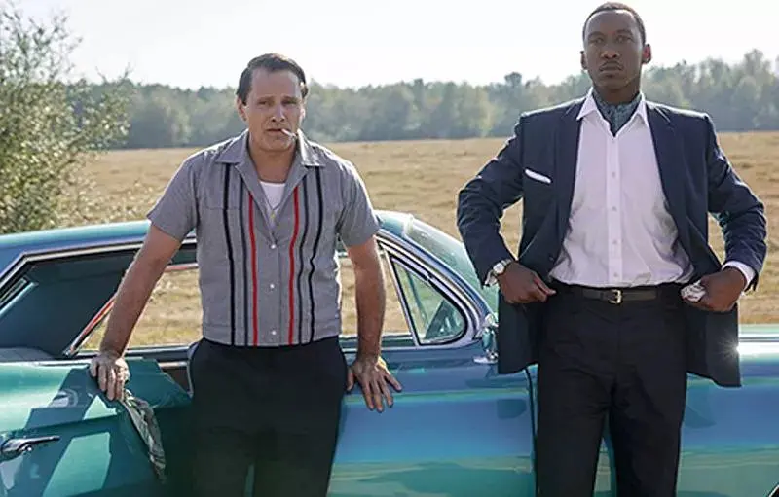
Main character introduction
Tony:car driver/bodyguard
uneducated bad-tempered
Racially discrimination
Tang:Musician
highly-educated
unfairly-treated

Slide 4
Contents summary
Tony lost job while Tang was going to have a performing tour in a place with racially discrimination and needed a bodyguard also car driver.
There is a vast difference between Tony and Tang so they were not harmonious in the first place.
After the first performing,Tony was shoked by Tong’s extraordinary technique of piano and gradually accepted this Black friend.
During their tours,they found themselves and the ice between Black and White melted gradually.

Slide 5
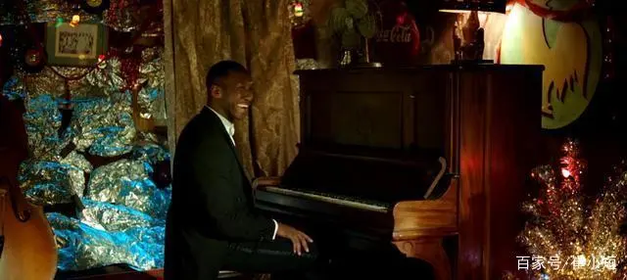
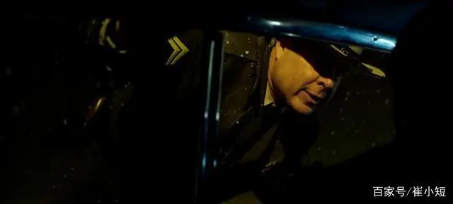
Unforgettable Scene
1.When Tong was discriminated by an alehouse,they came to another alehouse filled with black people and it’s the first time Tang felt real happiness from the bottom of his heart.
2.On the way home,they came across a police at Christmas.They guessed the police would make some troubles just like other police used to do when saw Tong’s colour.However，they are greeted by a concern and a blessing,”Happy Christmas!”

Slide 6
What does the film intend to tell us?
As its title refered,《Green Book》is a brochure,which records the place where is accessible to black people.By using it as the movie’s title, the director clearly pointed out the features of the special period,which shouldn’t be ignored.
Although it’s a cruel history,but it might still happen nowadays in some areas or countries.This movie attempt to let everyone know that there is nothing different between people in diferent skin colour.Everyone is created equal.

